Slide 1

DATA DIVERS Group Project DS311 Spring 2025
Contributors:
Josue Herrera
Giovanni Vallecillo
Zachary Hurt
Jennavieve Ledesma
Brian Solis
Matthew Riley

Slide 2

Home Team Advantage: Does it exist?
Home Team Advantage: The Evidence
Win Rate Difference: Teams win 51% of matches at home vs. 43% at neutral venues
Statistical Significance: p<0.001 confirms this 8% advantage is not random
Goal Scoring: Home teams score 0.3 more goals and concede 0.18 fewer goals
Tournament Impact: Advantage strongest in World Cup qualifiers (10.2%)
Consistent Pattern: Advantage persists across team strength levels

Slide 3

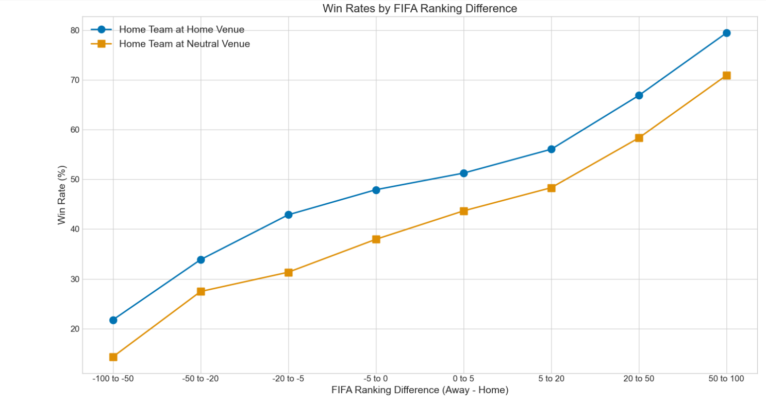
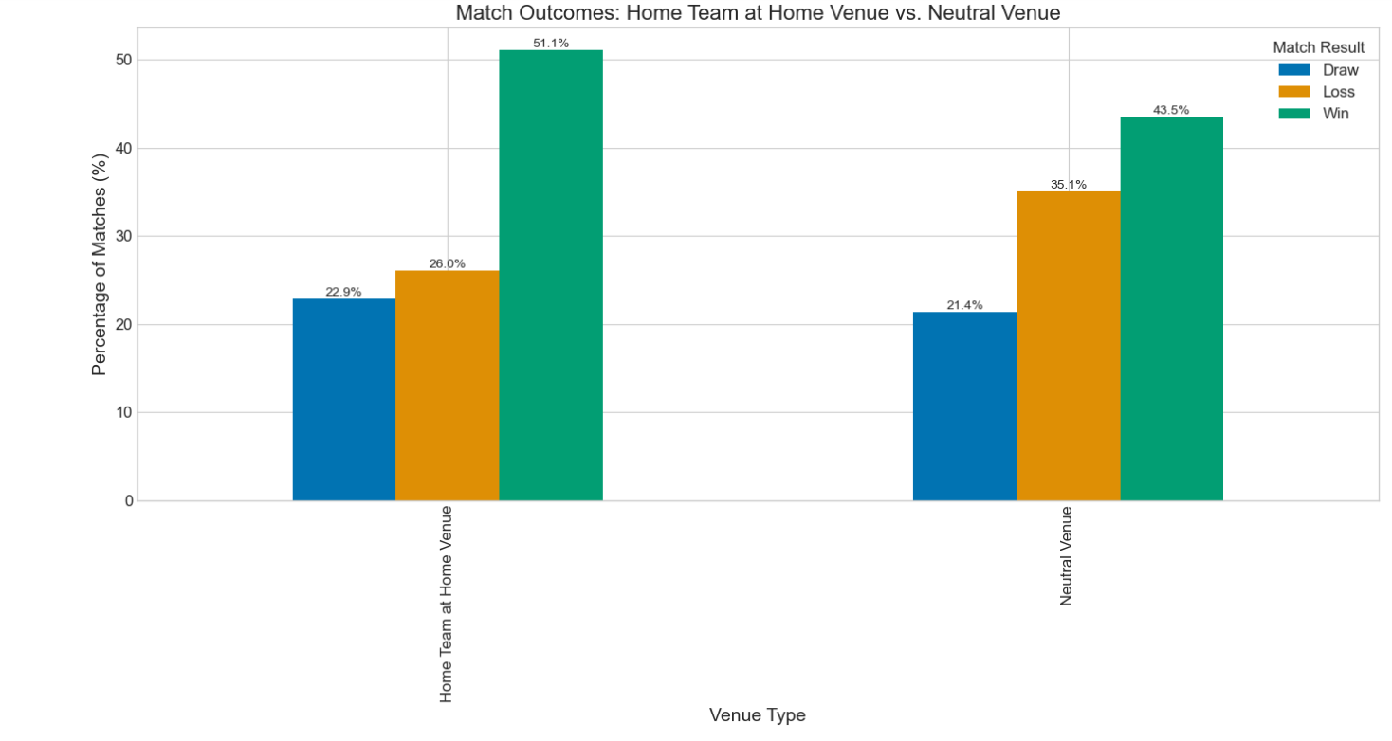
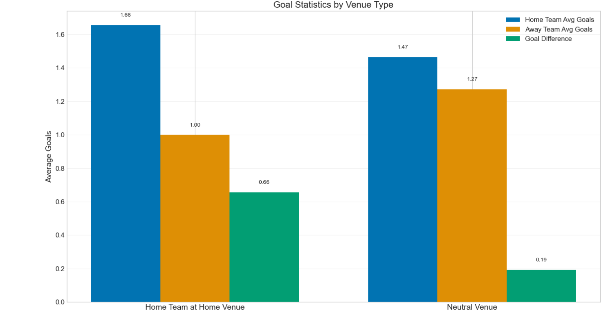
Home Team Advantage Continued..

Slide 4

Home Team Advantage Continued..
Why This Matters
Home advantage is real and quantifiable in international soccer
Teams should develop specific strategies for away matches
Tournament organizers should consider venue effects on competition fairness
Predictive models should incorporate 8%-win probability adjustment for home teams
Psychological factors likely contribute significantly to home team performance

